Slide 1

Progress Seminar on Online trading website
Presented By
Mr. Rohit Gourikar
Guided By
Mrs. Roshani Talmale
Department of Computer Science & Engineering
S. B. JAIN INSTITUTE OF TECHNOLOGY MANAGEMENT AND RESEARCH, NAGPUR
An Autonomous Institute, Affiliated to RTMNU, Nagpur

Slide 2
Contents
Problem Statement & Objectives
Introduction
Literature Survey
System Design
Use case Diagram
Technology to be Used
Modules
Advantages & Applications
References
S. B. Jain Institute of Technology Management and Research 2

Slide 3
Problem Statement & Objectives
Problem Statement :
Investing Is Essential To Achieve Your Goals In Today's World. It is the only way to make your future better. By making investments, Investments are made with the view of earning returns, which grows your amount invested to a higher sum. for doing business on a large scale every company needs large capital and a large and long term capital can be available only via a stock market
Objectives :
To inspire savings
To develop economy
To raise awareness
To do long-term financing
S. B. Jain Institute of Technology Management and Research 3

Slide 4
Introduction
This website is made to work as a stock broker. If you want to buy or sell the share we are providing you a Trading platform you have to make first your Demat Account R & R securities will help you to open your demat account within 10 min in a free of cost you just have to follow those steps.
Along with Equity Stocks, we are providing you a platform to invest in Cryptocurrency as well. Also you can invest in Fixed deposit, Mutual Funds and NPS from our platform.
S. B. Jain Institute of Technology Management and Research 4

Slide 5
Literature Survey
Websites | Findings
www.motilaloswal.com | Investment option in Bitcoin
www.E*trade.com | Investment option in mutual Fund
www.firstrade.com | Investment option in Fixed Deposit
S. B. Jain Institute of Technology Management and research 5

Slide 6
System Design: Flowchart
Start
Open Demat
Account
Start
Investment
Mutual fund
Bitcoin
Fixed Deposit
NPS
Stock Market
S. B. Jain Institute of Technology Management and research 6

Slide 7

Use case Diagram
Start
Open Demat
Account
Start
Investment
User
Buy or sell stock
Invest in FD,MF,BTC
End
S. B. Jain Institute of Technology Management and research 7

Slide 8
Technology to be Use
Front End : Html , Css
Library/API/Framework : CSS
IDE : VS Code
S. B. Jain Institute of Technology Management and research 8

Slide 9
Modules
User Module :
About
Product
Pricing
Contact
Open Demat Account
S. B. Jain Institute of Technology Management and research 9

Slide 10
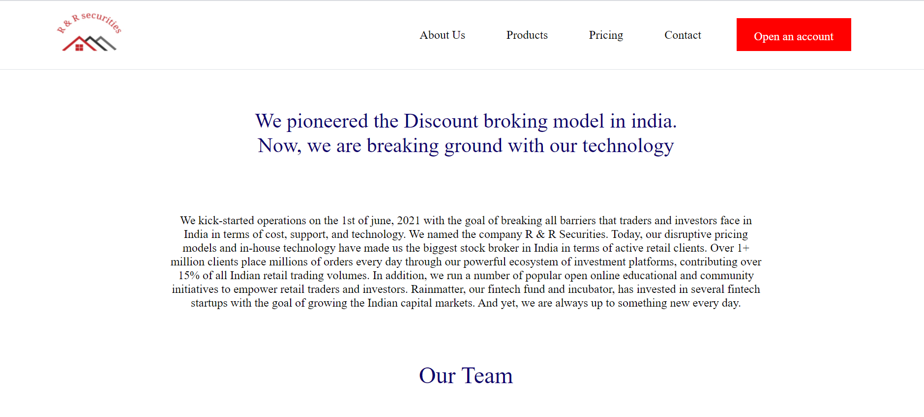

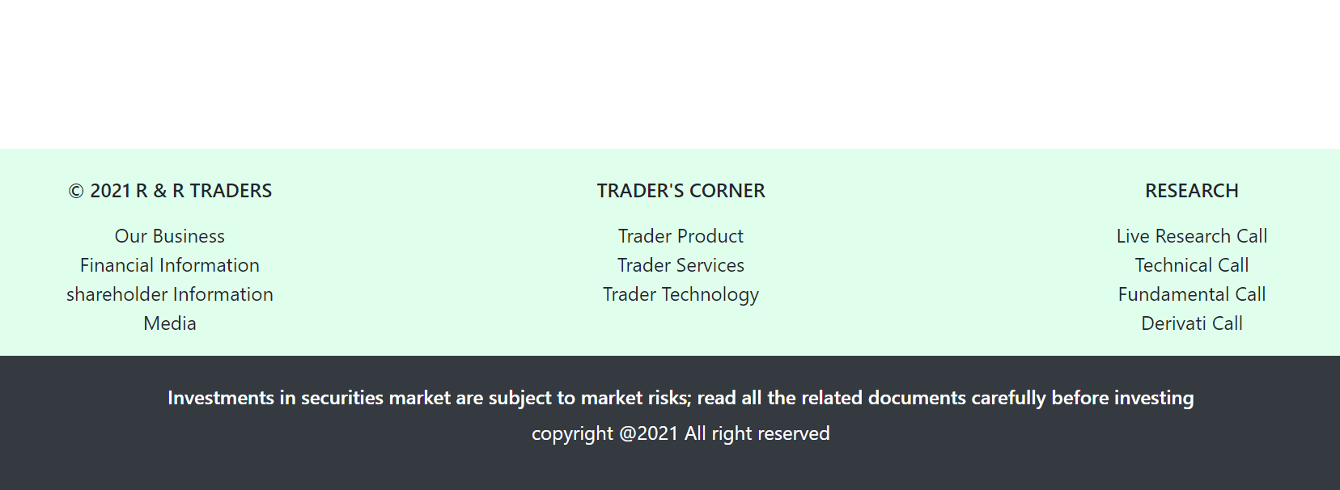
About :
S. B. Jain Institute of Technology Management and Research 10

Slide 11
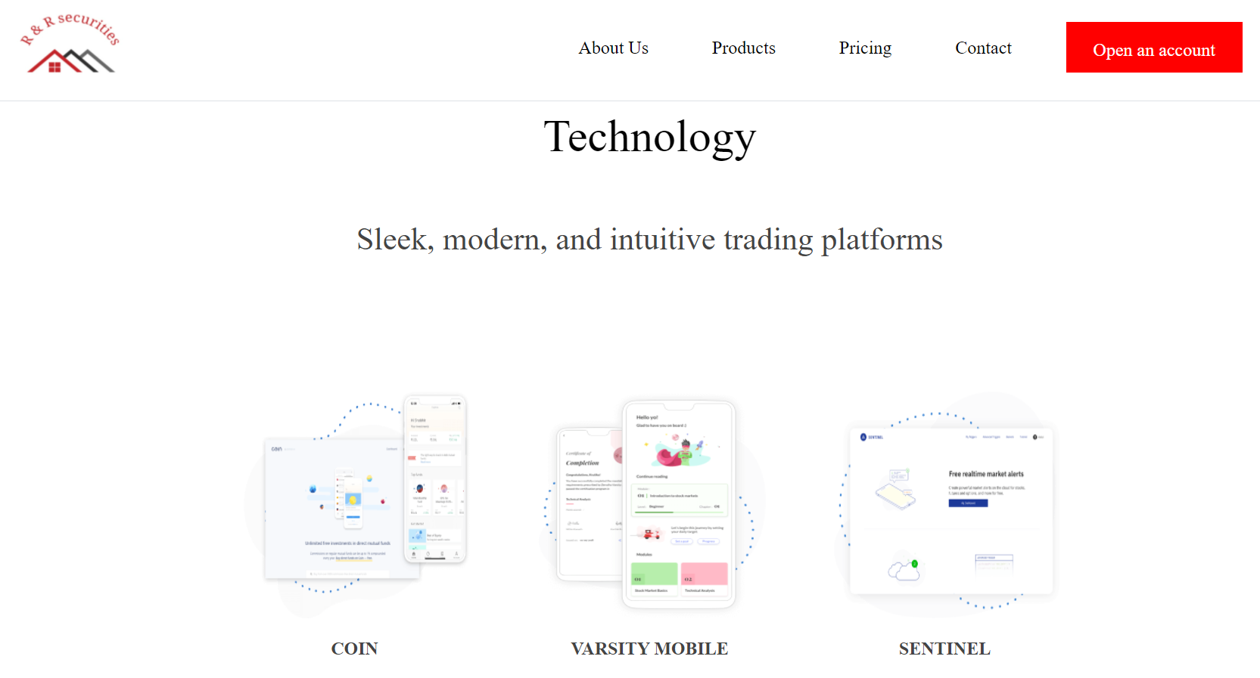
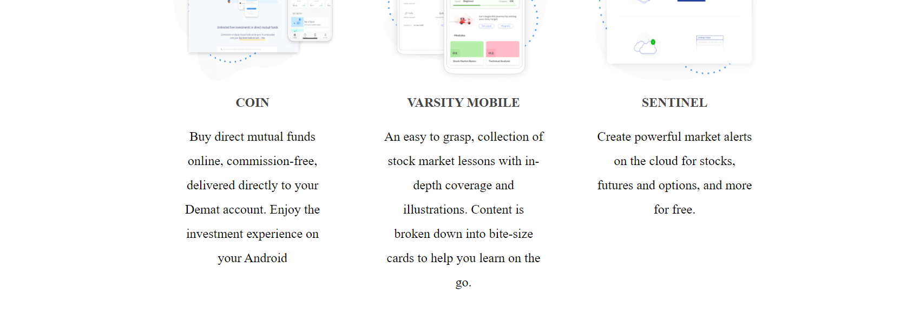
Product :
S. B. Jain Institute of Technology Management and Research 11

Slide 12
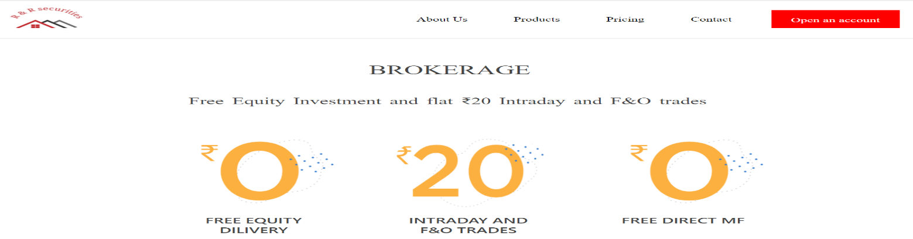
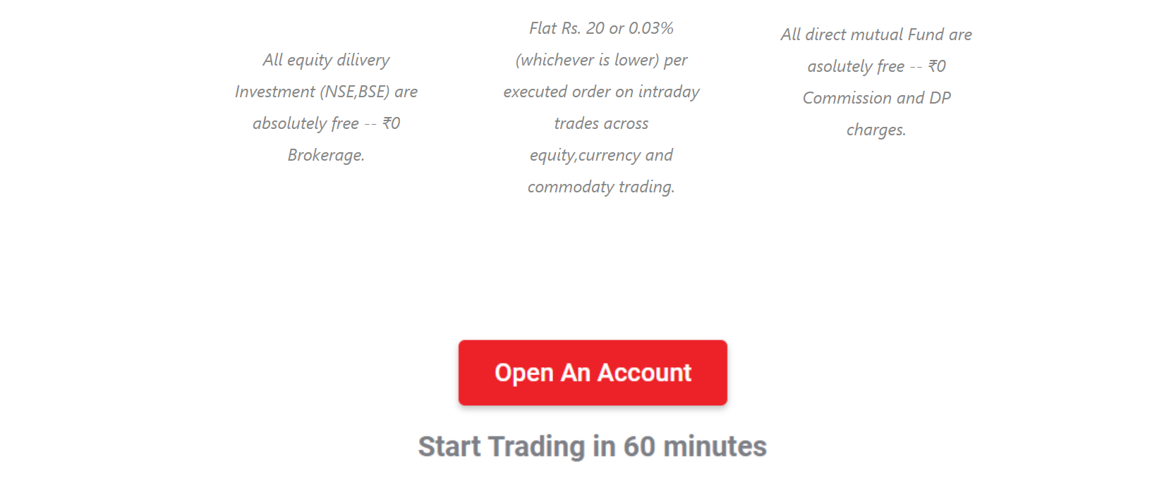
Pricing :
S. B. Jain Institute of Technology Management and Research 12

Slide 13
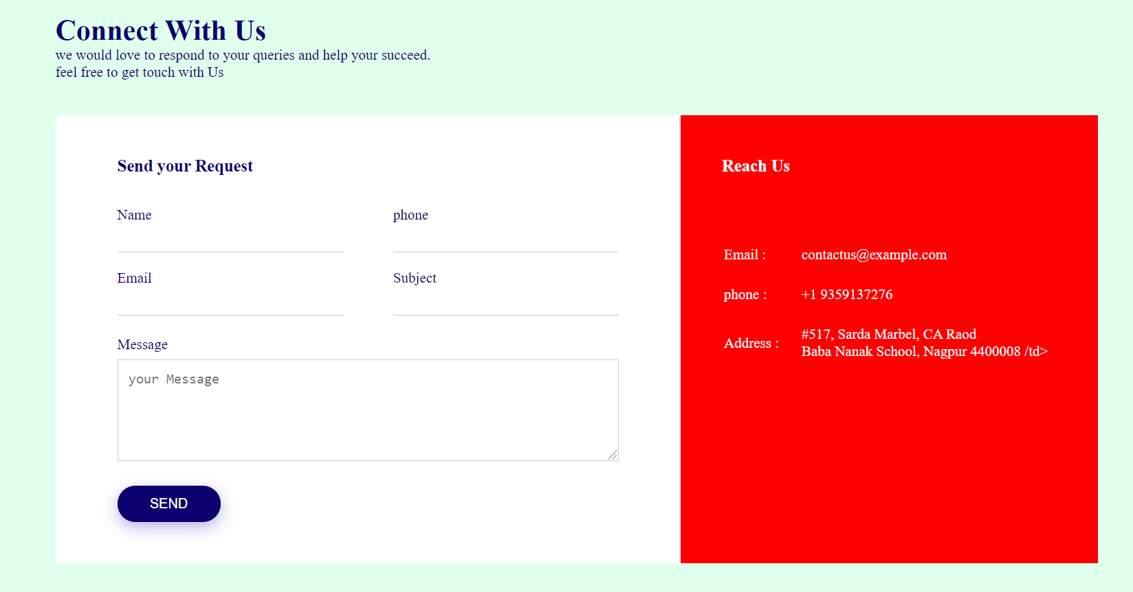
Contact :
S. B. Jain Institute of Technology Management and Research 13

Slide 14
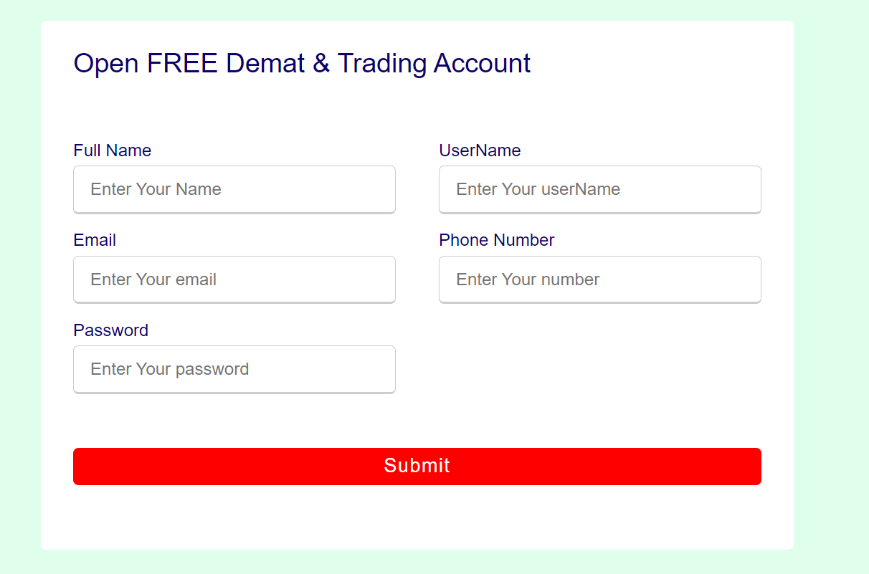
Open Demat Account :
S. B. Jain Institute of Technology Management and Research 14

Slide 15
Advantages & Applications
Advantages :
Probability of high returns over the short-term
Ownership stake in the company.
High liquidity.
Grow with economy.
Application :
user can buy or sell shares whenever we want.
user can make our investment easy and also can save time.
S. B. Jain Institute of Technology Management and research 15

Slide 16
References
Websites:
www.w3schools.com
www.thapatechnical.com
www.codecademy.com
S. B. Jain Institute of Technology Management and Research 16

Slide 17
Thank You

